Slide 1
Big Security Issues of Big Foundation Models
Neil Gong
Department of Electrical and Computer Engineering
Department of Computer Science (secondary appointment)
Duke University
06/23/2023

Slide 2
Foundation Models are “Operating Systems” of AI
Intelligent
Application
Foundation
Model
GPU, TPU,
CPU
Computer system
AI system

Slide 3
Security of Foundation Models
Insecure foundation model is a single point of failure of AI system
Securing foundation model secures AI ecosystem
This talk: vision foundation models
  E.g., CLIP
  Also called encoders

Slide 4
Road Map
Part I: Backdoor attack to pre-trained encoders
Part II: Data auditing for pre-trained encoders

Slide 5
Road Map
Part I: Backdoor attack to pre-trained encoders
Part II: Data auditing for pre-trained encoders

Slide 6
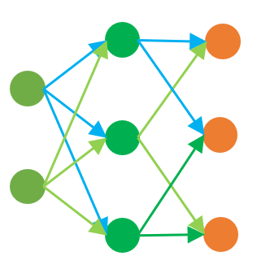
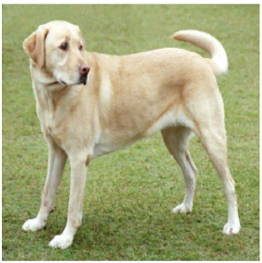
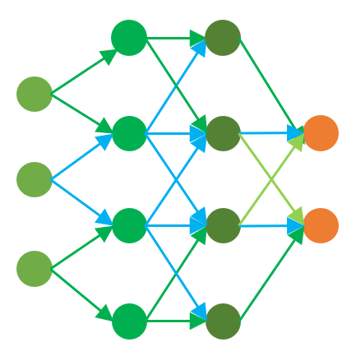
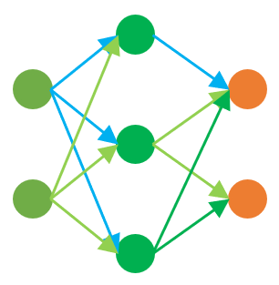
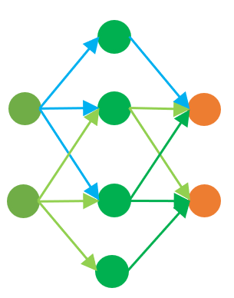
Background on Self-supervised Learning
Traffic sign
recognition
Social
media
…
Digit
recognition
Google
search
Object
classification
Internet
Unlabeled data
Encoder
Downstream tasks
Downstream classifiers
Images
(Image, Text) pairs

Slide 7
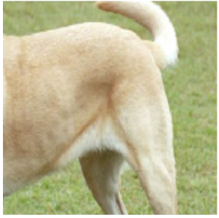
Data Augmentation
Augmented views
Crop and resize
Image
Horizontal flip
Rotation

Slide 8
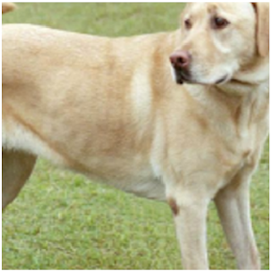
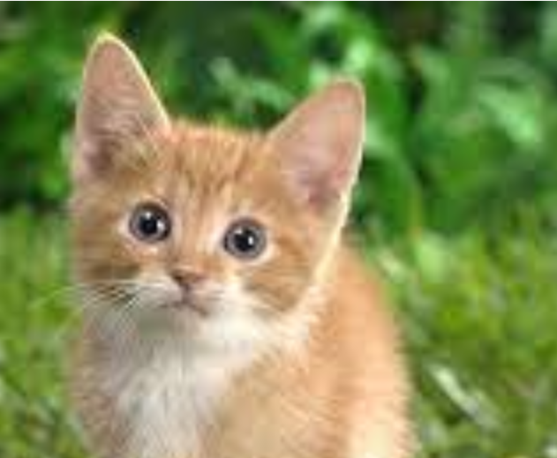
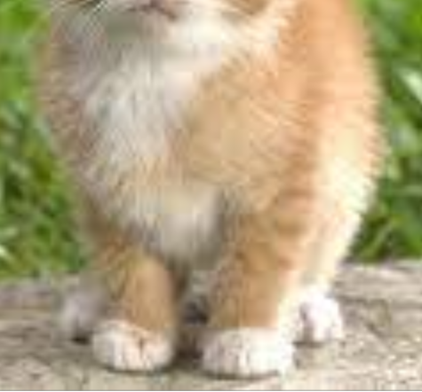
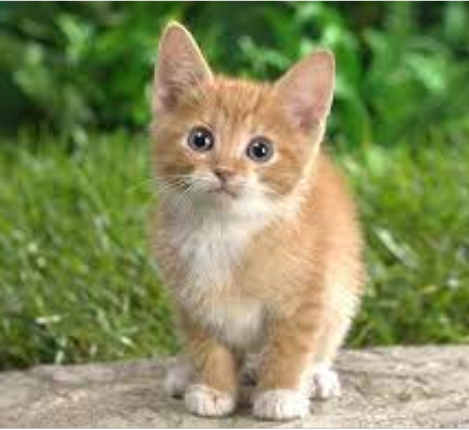
Pre-training an Encoder – SimCLR [ICML’20]
Similar
Dissimilar
Similar
Feature
vectors
[0.1, 0.3, $⋯$, 0.2]
[0.1, 0.1, $⋯$, 0.2]
[0.2, 0.0, $⋯$, 0.1]
[0.2, 0.1, $⋯$, 0.1]
Encoder
Augmented
views
Data
Augmentation

Slide 9
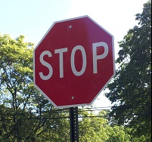

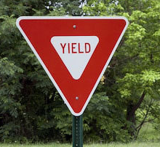
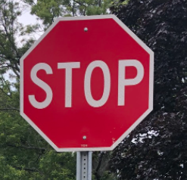
Building a Downstream Classifier
[0.1, 0.3, $⋯$, 0.2]
“stop”
[0.2, 0.1, $⋯$, 0.3]
“20 mi/h”
…
…
Supervised
learning
[0.3, 0.0, $⋯$, 0.1]
“yield”
Training inputs of
a downstream task
Encoder
Feature vectors
Labels
Downstream classifier
[0.0, 0.3, $⋯$, 0.2]
“stop”
Testing input
Encoder
Feature vector
Downstream classifier
Label

Slide 10
Backdoor Attack
[0.1, 0.3, $⋯$, 0.2]
“stop”
[0.2, 0.1, $⋯$, 0.3]
“20 mi/h”
…
…
Supervised
learning
[0.3, 0.0, $⋯$, 0.1]
“yield”
Training inputs of
a downstream task
Encoder
Feature vectors
Labels
Downstream classifier
Utility goal
[0.0, 0.3, $⋯$, 0.2]
“stop”
Testing input
Encoder
Feature vector
Downstream classifier
Label

Slide 11
Backdoor Attack
[0.1, 0.3, $⋯$, 0.2]
“stop”
[0.2, 0.1, $⋯$, 0.3]
“20 mi/h”
…
…
Supervised
learning
[0.3, 0.0, $⋯$, 0.1]
“yield”
Training inputs of
a downstream task
Encoder
Feature vectors
Labels
Downstream classifier
Backdoor trigger
Effectiveness
goal
[0.0, 0.3, $⋯$, 0.2]
“stop”
Testing input
Encoder
Feature vector
Downstream classifier
Label

Slide 12
Backdoor Attack
[0.1, 0.3, $⋯$, 0.2]
“stop”
[0.2, 0.1, $⋯$, 0.3]
“20 mi/h”
…
…
Supervised
learning
[0.3, 0.0, $⋯$, 0.1]
“yield”
Training inputs of
a downstream task
Encoder
Feature vectors
Labels
Downstream classifier
Backdoor trigger
Effectiveness
goal
[0.0, 0.3, $⋯$, 0.2]
“60 mi/h”
Testing input
Encoder
Feature vector
Downstream classifier
Label

Slide 13
Backdoor Attack
[0.1, 0.3, $⋯$, 0.2]
“stop”
[0.2, 0.1, $⋯$, 0.3]
“20 mi/h”
…
…
Supervised
learning
[0.3, 0.0, $⋯$, 0.1]
“yield”
Training inputs of
a downstream task
Encoder
Feature vectors
Labels
Downstream classifier
Our backdoor attack
Existing backdoor attacks
Backdoor trigger
Effectiveness
goal
[0.0, 0.3, $⋯$, 0.2]
“60 mi/h”
Testing input
Encoder
Feature vector
Downstream classifier
Target label

Slide 14


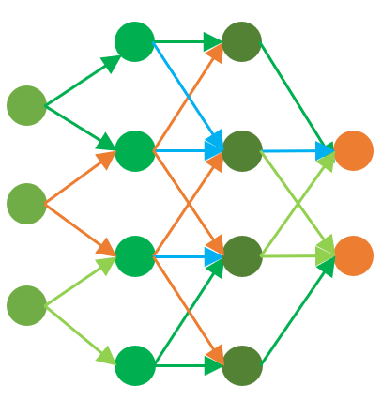
Our BadEncoder
Traffic sign
recognition
BadEncoder
Digit
classification
Clean
encoder
Backdoored
encoder
Object
classification
Jinyuan Jia, Yupei Liu, and Neil Zhenqiang Gong. “BadEncoder: Backdoor Attacks to Pre-trained Encoders in Self-Supervised Learning”. In IEEE Symposium on Security and Privacy, 2022

Slide 15

Threat Model
One target downstream task
  E.g., traffic sign recognition
One target label
  E.g., “60 mi/h”
One backdoor trigger
  E.g., a white square in the center of an image
Attacker’s goal
  Effectiveness goal
  Utility goal
Attacker’s background knowledge
  Unlabeled images
    Called attack dataset
  Image with target label
Reference image

Slide 16
Key Idea of Our Attack
Formulate as an optimization problem
  Effectiveness loss
    Quantify effectiveness goal
  Utility loss
    Quantify utility goal
  Minimize a weighted sum of the two losses

Slide 17
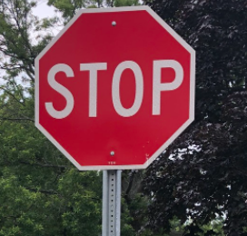
Quantifying Effectiveness Goal
$$f′$$
Reference image
Condition I:
$$f′$$
$$≈$$
+
Condition II:
$$f′$$
$$≈$$
$$f$$
“60 mi/h”
$$f′$$
“60 mi/h”
Target label
$f′(x)$: feature vector for $x$

Slide 18
Quantifying Condition I
Embedding backdoor trigger $e$ to $x$
Cosine similarity
Reference image
Attack dataset
Backdoored
encoder
Normalization

Slide 19
Quantifying Condition II
Backdoored encoder
Clean encoder
Cosine similarity
Reference image
Quantifying effectiveness goal:
Hyperparameter

Slide 20
Quantifying Utility Goal
Classification of an image without backdoor trigger is unaffected
$$f′(x)≈f(x)$$
Cosine similarity
Attack dataset

Slide 21
Optimization Problem
Quantifying effectiveness goal
Quantifying utility goal
$L=L_{0}+ λ_{1}∙L_{1}$ + $λ_{2}∙L_{2}$
Two hyperparameters
Minimizing L
$$f$$
$f′$

Slide 22
Experimental Setup
Pre-training encoders
  Pre-training algorithm
    SimCLR
  Pre-training dataset
    CIRAR10
Building downstream classifiers
  Downstream tasks
    GTSRB, SVHN, STL10
  Downstream classifier
    A fully connected neural network

Slide 23
Attack Setting
Attack dataset
  Pre-training dataset
Target label
  Different for different target downstream tasks
Reference image
  Collected from the Internet
Hyperparameters

Slide 24

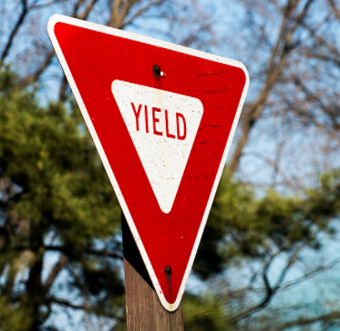
Evaluating Effectiveness via Attack Success Rate
[0.1, 0.3, $⋯$, 0.2]
“60 mi/h”
“40 mi/h”
“60 mi/h”
Downstream
classifier
$f′$
[0.2, 0.1, $⋯$, 0.3]
Built upon $f′$
…
…
…
…
[0.3, 0.0, $⋯$, 0.1]
Fraction of“60 mi/h”

Slide 25
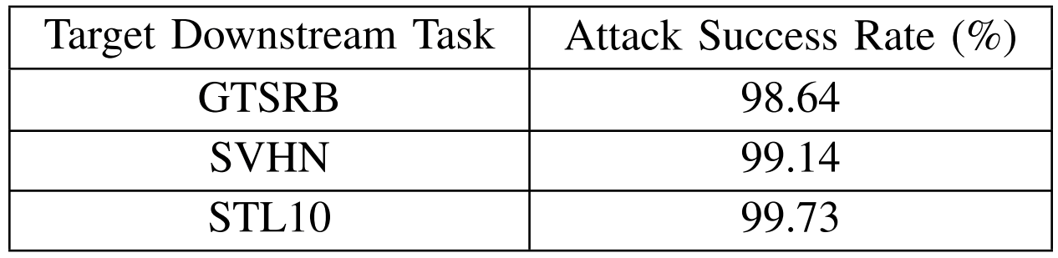
BadEncoder Achieves Effectiveness Goal

Slide 26
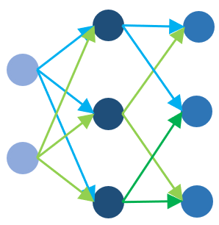
Evaluating Utility via Clean Accuracy and Backdoored Accuracy
Downstream
classifier
“stop”
“50 mi/h”
“yield”
$f$
Clean Accuracy
…
Built upon $f$
“stop”
“40 mi/h”
“priority”
…
$f′$
Backdoored Accuracy
…
Built upon $f′$

Slide 27
BadEncoder Achieves Utility Goal
Target Downstream Task | Clean Accuracy (%) | Backdoored Accuracy (%)
GTSRB | 81.84 | 82.27
SVHN | 58.50 | 69.32
STL10 | 76.14 | 76.18

Slide 28
Evaluation on Real-world Pre-trained Encoders
OpenAI’s encoder CLIP
  400 million (image, text) pairs collected from the Internet
Attack dataset
  ImageNet dataset

Slide 29
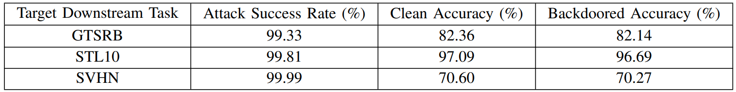
Results for CLIP
BadEncoder achieves effectiveness goal
BadEncoder achieves
utility goal

Slide 30
Existing Defenses are Insufficient
Empirical defenses
  Neural Cleanse [Oakland’19]
    Cannot detect backdoored encoder
  MNTD [Oakland’21]
    Detection accuracy is close to random guessing
Provable defense
  PatchGuard [USENIX Security’21]
    Insufficient provable robustness guarantees

Slide 31
Summary
Pre-trained encoders are vulnerable to backdoor attack
Insecure encoders lead to a single point of failure of AI ecosystem
Existing defenses are insufficient to defend against BadEncoder

Slide 32
Road Map
Part I: Backdoor attack to pre-trained encoders
Part II: Data auditing for pre-trained encoders

Slide 33
Motivation on Data Auditing
Traffic sign
recognition
Social
media
…
Digit
recognition
Google
search
Object
classification
Internet
Unlabeled data
Encoder
Paid service for downstream customers

Slide 34
OpenAI’s GPT API
ChatGPT Plus: $20/month

Slide 35
Auditing Unauthorized Data Use
Was my public data used to pre-train a given encoder
without authorization?

Slide 36
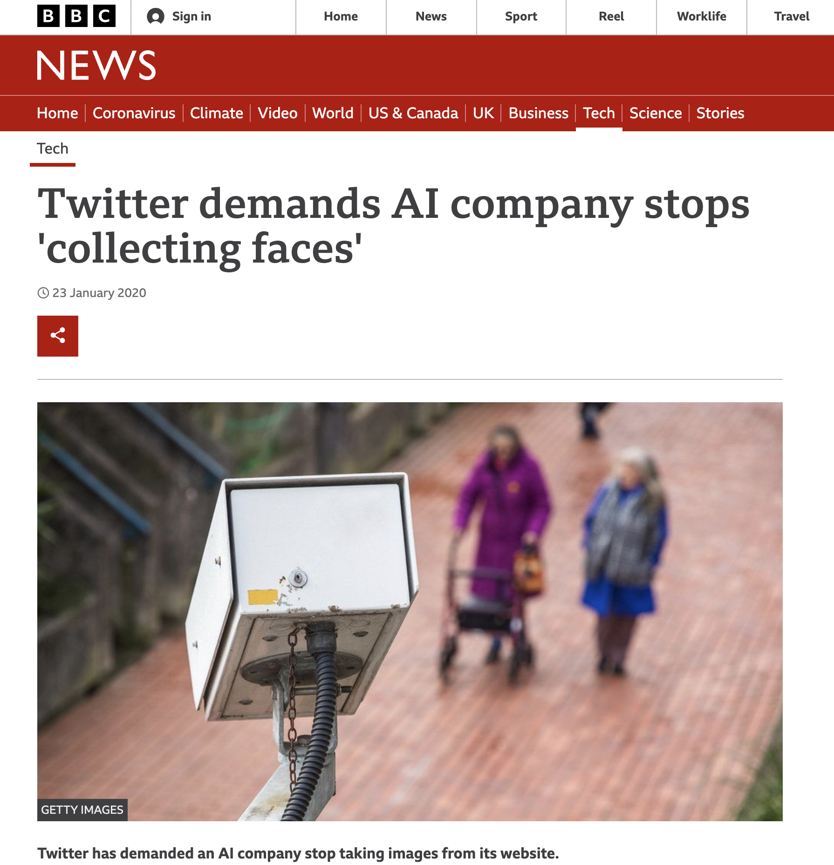
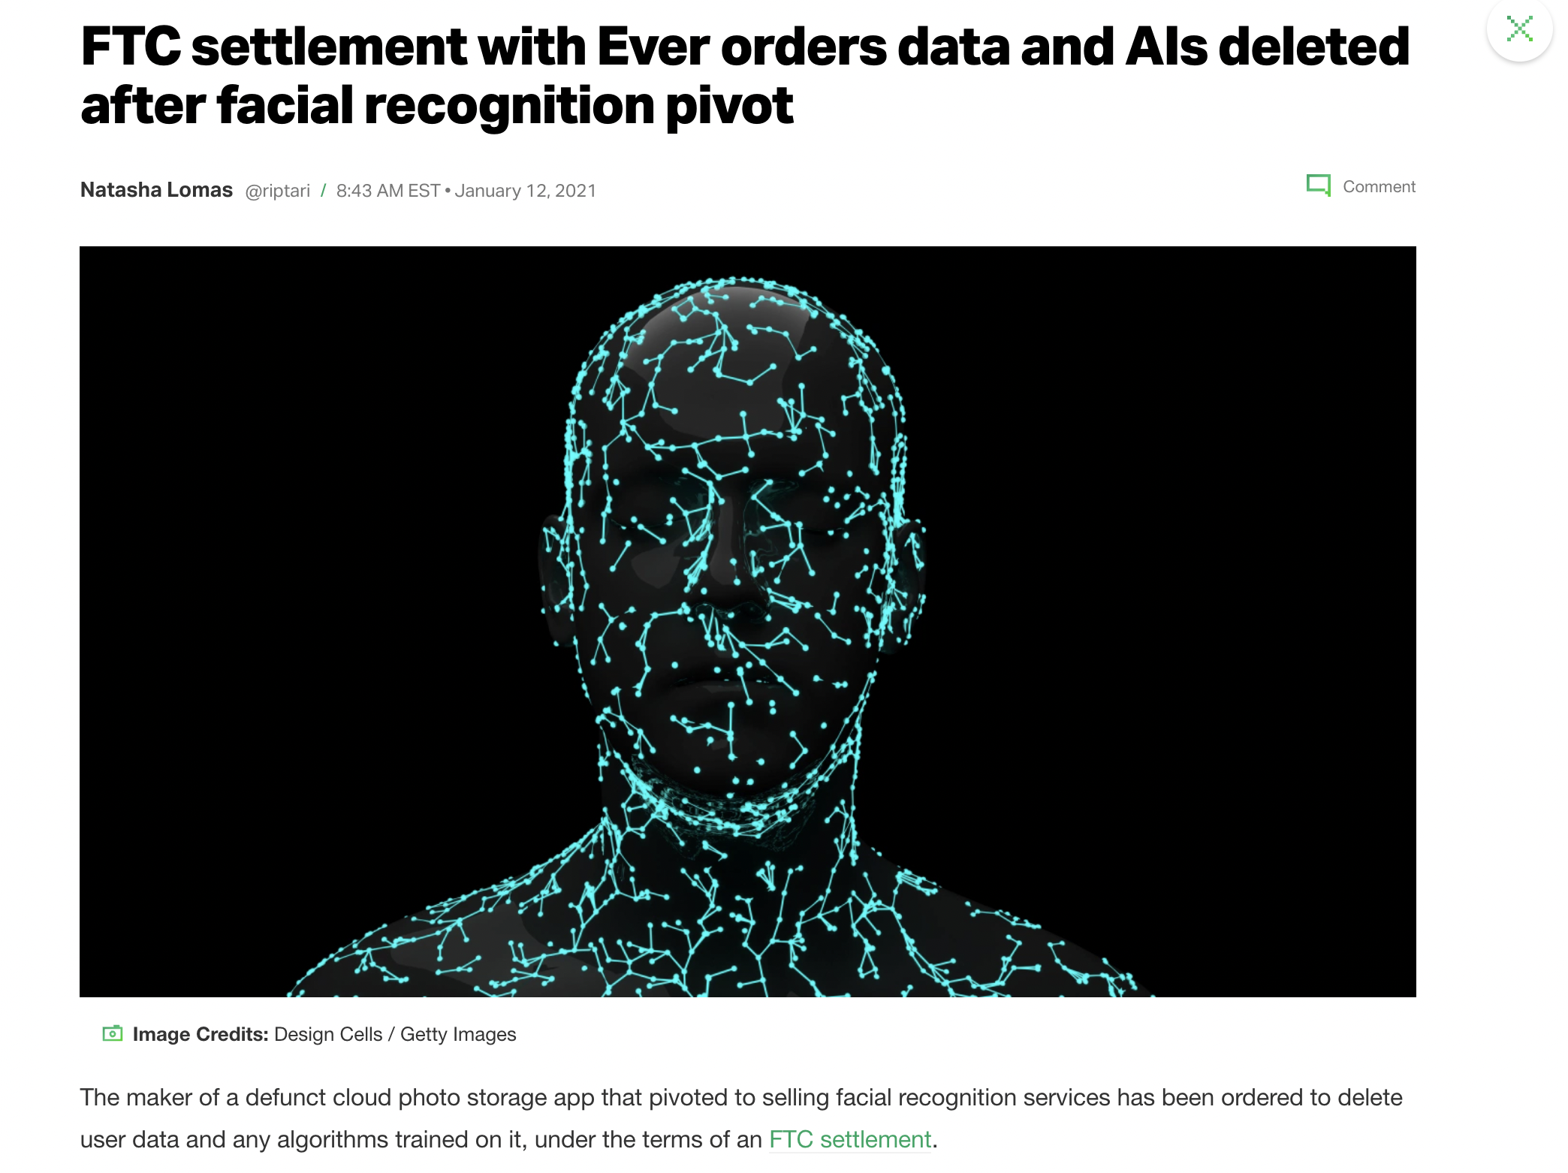
Examples of Real-world Unauthorized Data Use

Slide 37
Our EncoderMI: Membership Inference based Data Auditing for Pre-trained Encoders
Target
encoder
Member, i.e.,
unauthorized use
EncoderMI
Unlabeled
image
Non-member
Hongbin Liu, Jinyuan Jia, Wenjie Qu, and Neil Zhenqiang Gong. “EncoderMI: Membership Inference against Pre-trained Encoders in Contrastive Learning”. In ACM Conference on Computer and Communications Security (CCS), 2021.

Slide 38

Threat Model: Black-box Access
Image
Target
encoder
Feature
vector

Slide 39
Revisiting Encoder Pre-training
Similar
Feature
vectors
Target
encoder
Augmented
views
Data
Augmentation

Slide 40
Our Key Observation
More similar
Less similar
Feature
vectors
Target
encoder
Augmented
views
Data
Augmentation
Member
Non-member

Slide 41


Overview of Our EncoderMI
$\frac{N⋅(N−1)}{2}$ pairwise similarity scores
Member or Non-member
Image
Target encoder
Inference classifier
Built via shadow training
$N$ augmented views
$N$ feature vectors

Slide 42
Shadow Training Setup
Unlabeled images: shadow dataset
Evenly divide into two halves
  Shadow member set
  Shadow non-member set

Slide 43
Pre-training a Shadow Encoder
  Shadow member set
  Shadow encoder

Slide 44

Constructing a Training Set for Inference Classifier
  Shadow member set
Member
  N augmented
  views
  Shadow encoder
  N feature
  vectors
  Features
  Label
$\frac{N⋅(N−1)}{2}$ pairwise similarity scores
1
Training set
$\frac{N⋅(N−1)}{2}$ pairwise similarity scores
0
  Shadow
  non-member set
Non-member
  N augmented
  views
  Shadow encoder
  N feature
  vectors
  Features
  Label

Slide 45
Building an Inference Classifier
Vector-based classifier
Rank similarity scores
$\frac{N⋅(N−1)}{2}$ pairwise similarity scores
1
Set of similarity scores
Set-based classifier
$\frac{N⋅(N−1)}{2}$ pairwise similarity scores
0
Average similarity score
Training set
Threshold-based classifier

Slide 46
Experimental Setup
Pre-training target encoder
  Pre-training algorithm
    MoCo
  Pre-training dataset
    CIFAR10
  Target encoder architecture
    ResNet18
Pre-training shadow encoder
  Pre-training algorithm
    SimCLR
  Pre-training dataset
    STL10
  Shadow encoder architecture
    VGG11
N=10

Slide 47
Evaluation Metrics
10,000 members of target encoder
10,000 non-members of target encoder
Accuracy
  Fraction of members/non-members whose memberships are inferred correctly

Slide 48
EncoderMI is Effective
Vector-based classifier | Set-based classifier | Threshold-based classifier
86.2% | 78.1% | 82.1%

Slide 49


Evaluation on CLIP
How to collect members and non-members of CLIP?
1,000 images
2,000 images
Potential members
Member or Non-member
EncoderMI
1,000 images
Ground truth non-members

Slide 50
EncoderMI is Effective for CLIP
Vector-based classifier | Set-based classifier | Threshold-based classifier
73.5% | 72.7% | 74.5%

Slide 51
Summary
Data auditing is an emerging problem for pre-trained encoders
Feature similarity between augmented views can be used to audit unauthorized data use in pre-trained encoders

Slide 52
StolenEncoder
Target
encoder
Stolen
encoder
Similar utility
Less data & computation resource
Yupei Liu, Jinyuan Jia, Hongbin Liu, and Neil Zhenqiang Gong. "StolenEncoder: Stealing Pre-trained Encoders in Self-supervised Learning". In ACM CCS, 2022.

Slide 53
Robust Encoder as a Service
Standard encoder as a service
Robust encoder as a service
Wenjie Qu, Jinyuan Jia, and Neil Zhenqiang Gong. "REaaS: Enabling Adversarially Robust Downstream Classifiers via Robust Encoder as a Service". In ISOC Network and Distributed System Security Symposium (NDSS), 2023.

Slide 54
Conclusion
Part I: Backdoor attack to pre-trained encoders
  “BadEncoder: Backdoor Attacks to Pre-trained Encoders in Self-Supervised Learning”. In IEEE Symposium on Security and Privacy, 2022.
Part II: Data auditing for pre-trained encoders
  “EncoderMI: Membership Inference against Pre-trained Encoders in Contrastive Learning”. In ACM CCS, 2021.
Acknowledgements
Jinyuan Jia
Hongbin Liu
Yupei Liu
Wenjie Qu

